Slide 1
Discussion talk at the seminar days 2015
Experimental characterization and optimization of a high-
resolution x-ray grating interferometer setup with respect
to material research.

Slide 2
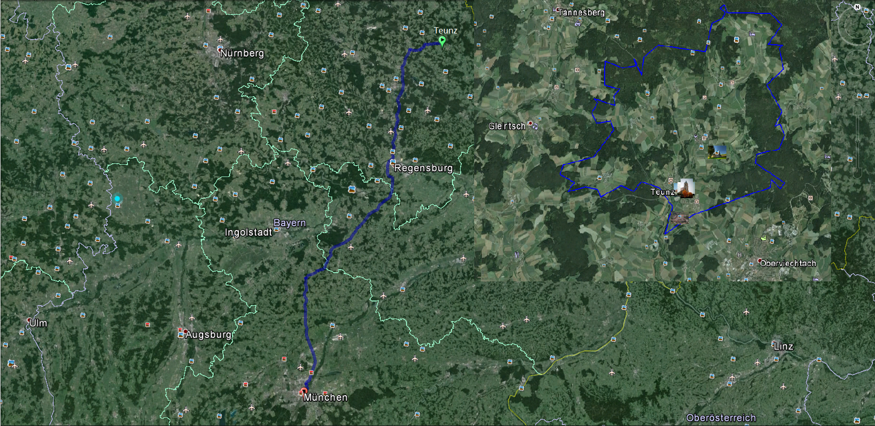
About Me
Full name: Markus Josef Baier
Birthday: 19.03.1991
School: 2001-2010
Musikgymnasium der Regensburger Domspatzen
University:
TU München: 2010-2014 Bachelor of science
At present:
Master of science

Slide 3
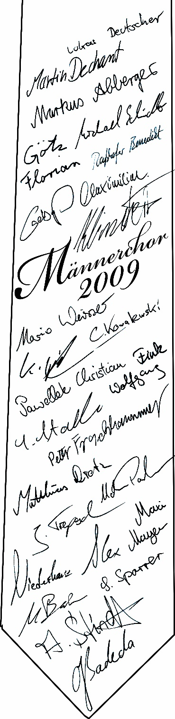
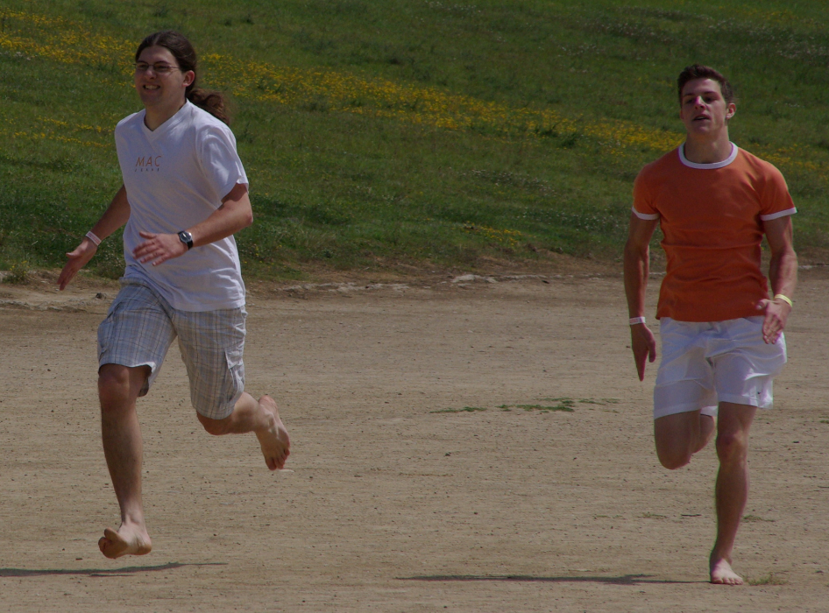
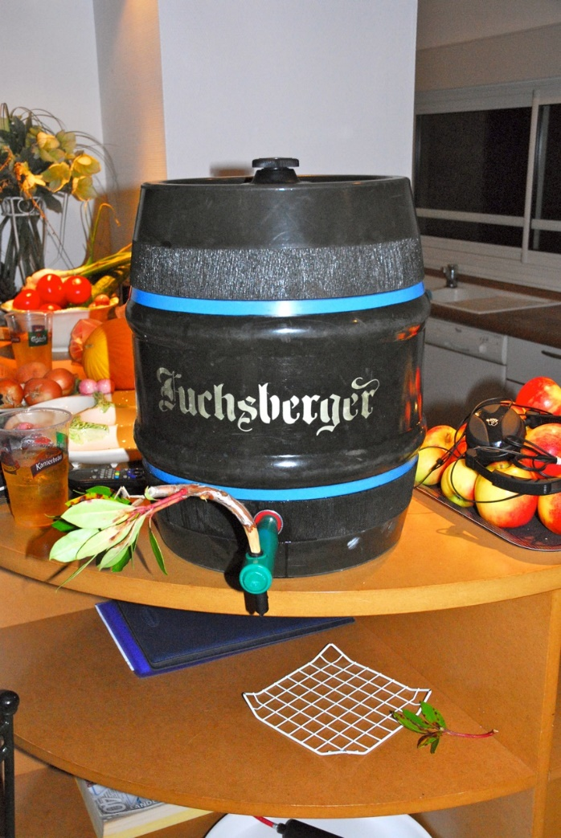
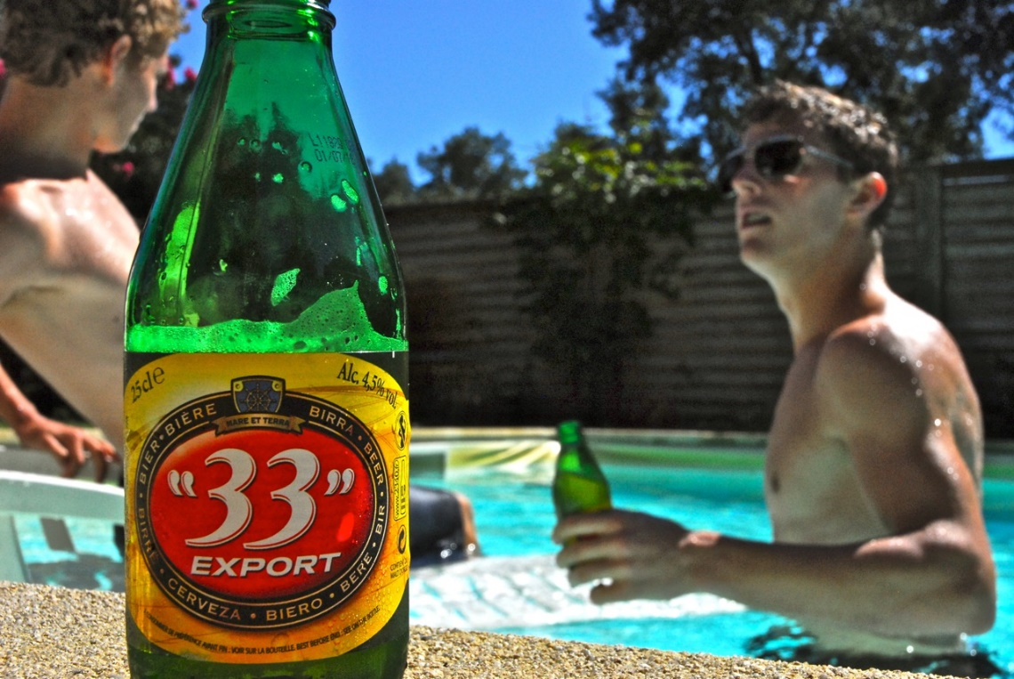
About Me
Hobbies:
Soccer, climbing, singing, swimming, travelling
Favourite Beer
Helles: Fuchsberger
Weizen: Schneider Weisse

Slide 4
Experimental characterization and optimization of a high-resolution x-ray grating interferometer setup with respect to material research.

Slide 5
Stability measurements of detector and source
Response of the detector for the same source output-intensity but different integration times
Dependency of the source output-intensity by variation of the input-power

Slide 6
Long-period output-intensity and visibility measurement
Mean intensity measurement over a time period of two days
Change of visibility during a time period of two days

Slide 7
Detector PSF for vertical and horizontal direction
PSF of the detector for different powers for both vertical and horizontal axis

Slide 8
Measurement of the source size using a knife edge
Top: Data and edge fits for different magnifications
Bottom: Gaussian fits for the corresponding edge fits above
Diagonal spot sizes for different input-powers at 60 kVp and different magnificaitions

Slide 9
Measurement of the source size using a knife edge
Vertical spot sizes for different input-powers at 60 kVp and different magnifications
Horizontal spot sizes for different input-powers at 60 kVp and different magnifications

Slide 10
Measurement of the source size using a resolution target
Left: Stitched image of the complete resolution target for 3 Watt input-power.
Below: Projection of the resolution target lines retrieving the contrast.
Retrieved MTF’s of the resolution target for different powers at 60 kVp

Slide 11
Measurement of the source spectrum for different energies

Slide 12
Energy resolved stepping and energy visibility map
Measurement of the phase stepping over a complete period at 100kVp and 10 watts. The counting time: 300s with the CdTe amptec.
Corresponding energy visibility map

Slide 13
Further results
Comparison of different phase grating setups as well as pure absorption grating setups, with respect to visibility, phase shift and sensitivity.
Stepping without a mechanical stepper, instead whit the bending coils of the source

Slide 14
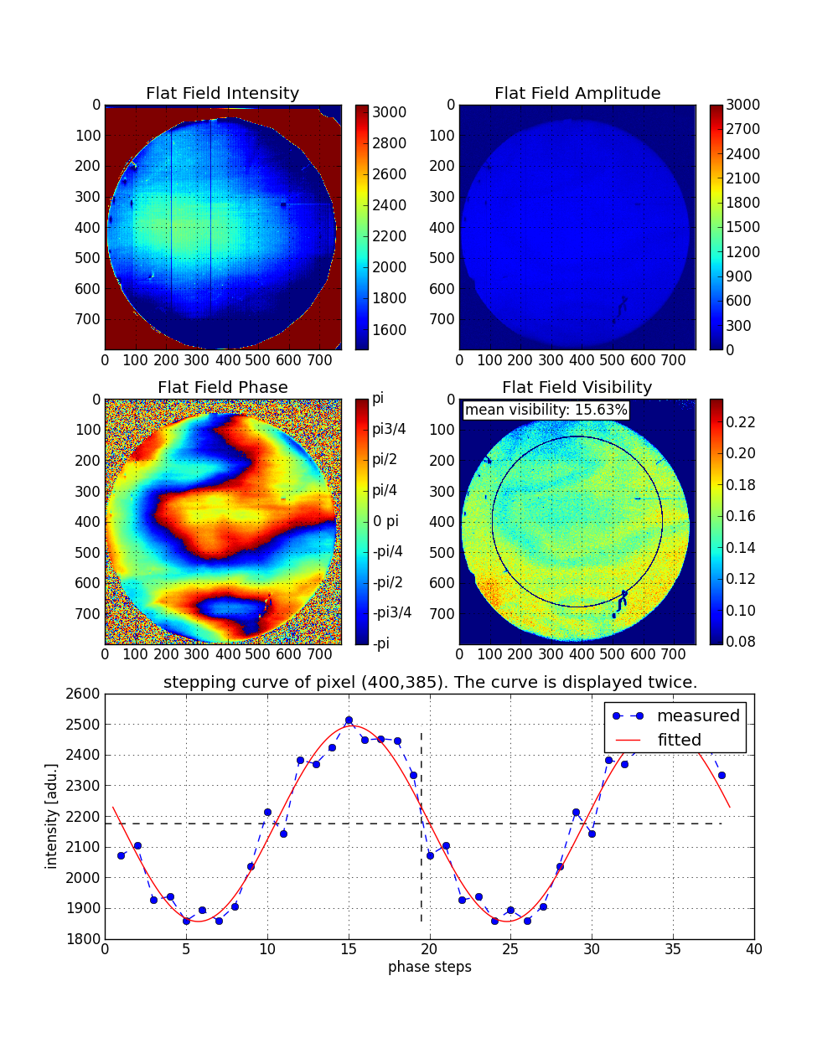
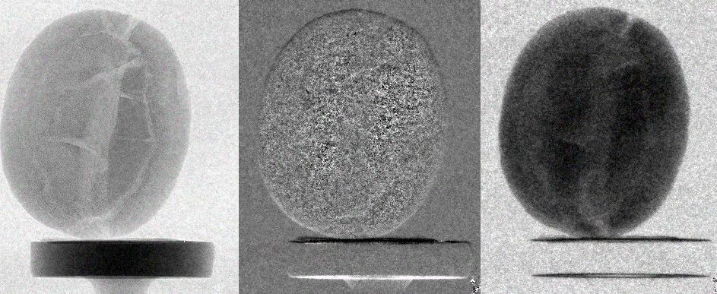
Stepping with the source deflection coils
Left: Processing of the deflection stepping
Bottom: Resulting images for the different signals
AMP
DPC
DCI

Slide 15
Further results
Comparison of different phase grating setups as well as pure absorption grating setups, with respect to visibility, phase shift and sensitivity.
Stepping without a mechanical stepper, instead whit the bending coils of the source
Different methods improving the focussing ability of the source
At Measurements near the source just rotate the sample out of the beam, avoiding massive vibrations of the source grating.

Slide 16
Thank you for you attention!
Questions?

Slide 17
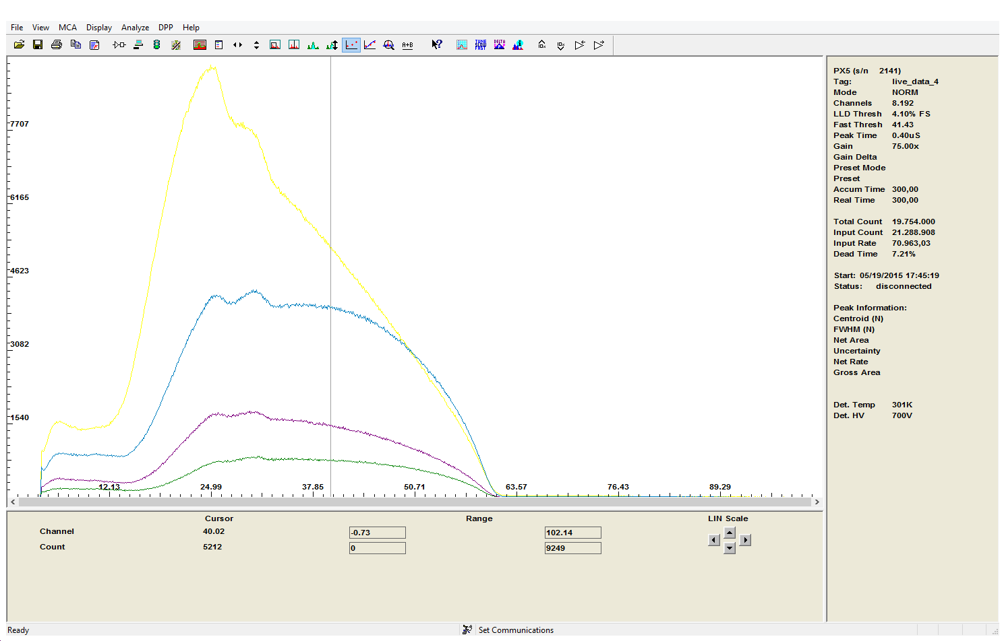
Spectrum without gratings
60kV source Voltage
Spectrum with G0
Spectrum with G1+G2
Spectrum with all gratings

Slide 18
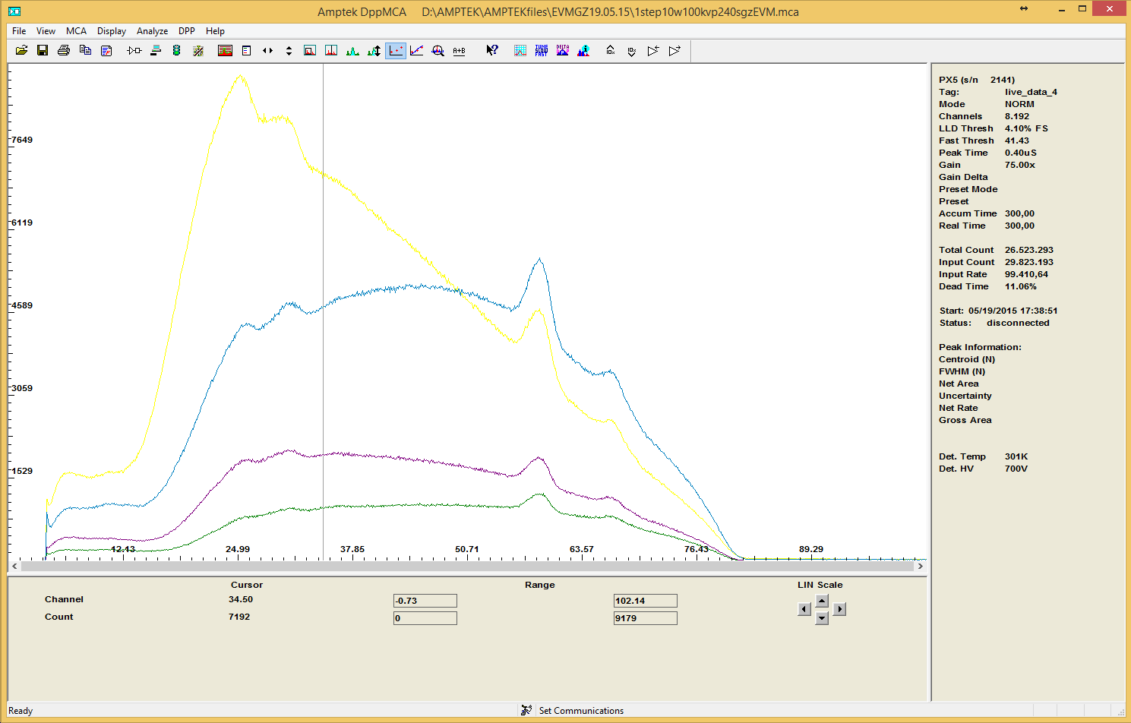
Spectrum without gratings
80kV source Voltage
Spectrum with G0
Spectrum with G1+G2
Spectrum with all gratings

Slide 19
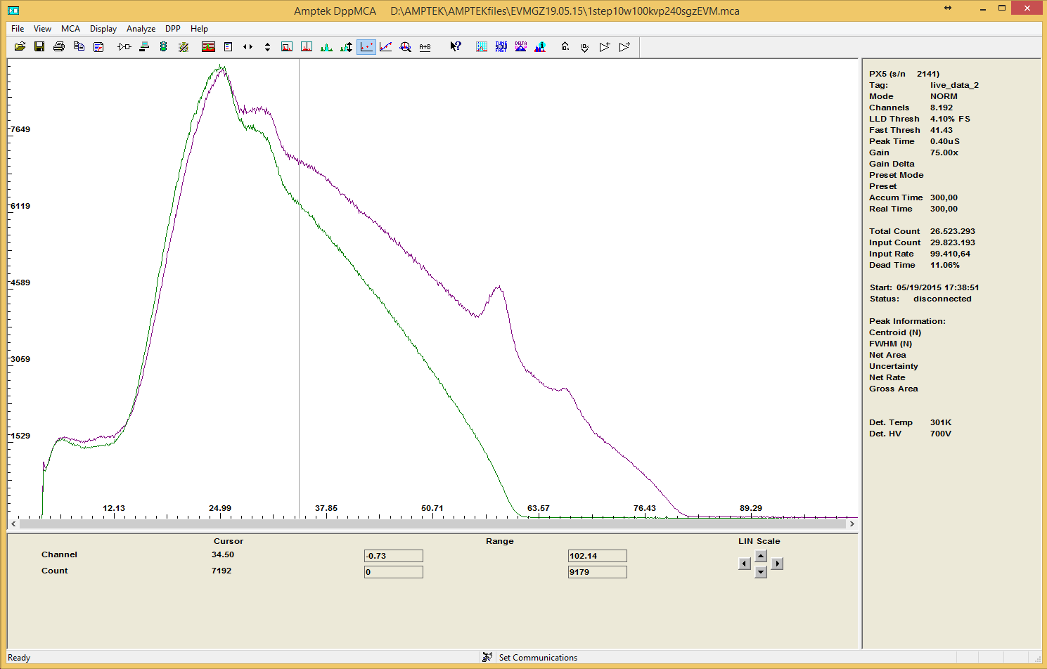
Spectra of the source without gratings in a distance of one meter the green line is taken at 60kV, the purple one for 80kV source Voltage, respectively

Slide 20
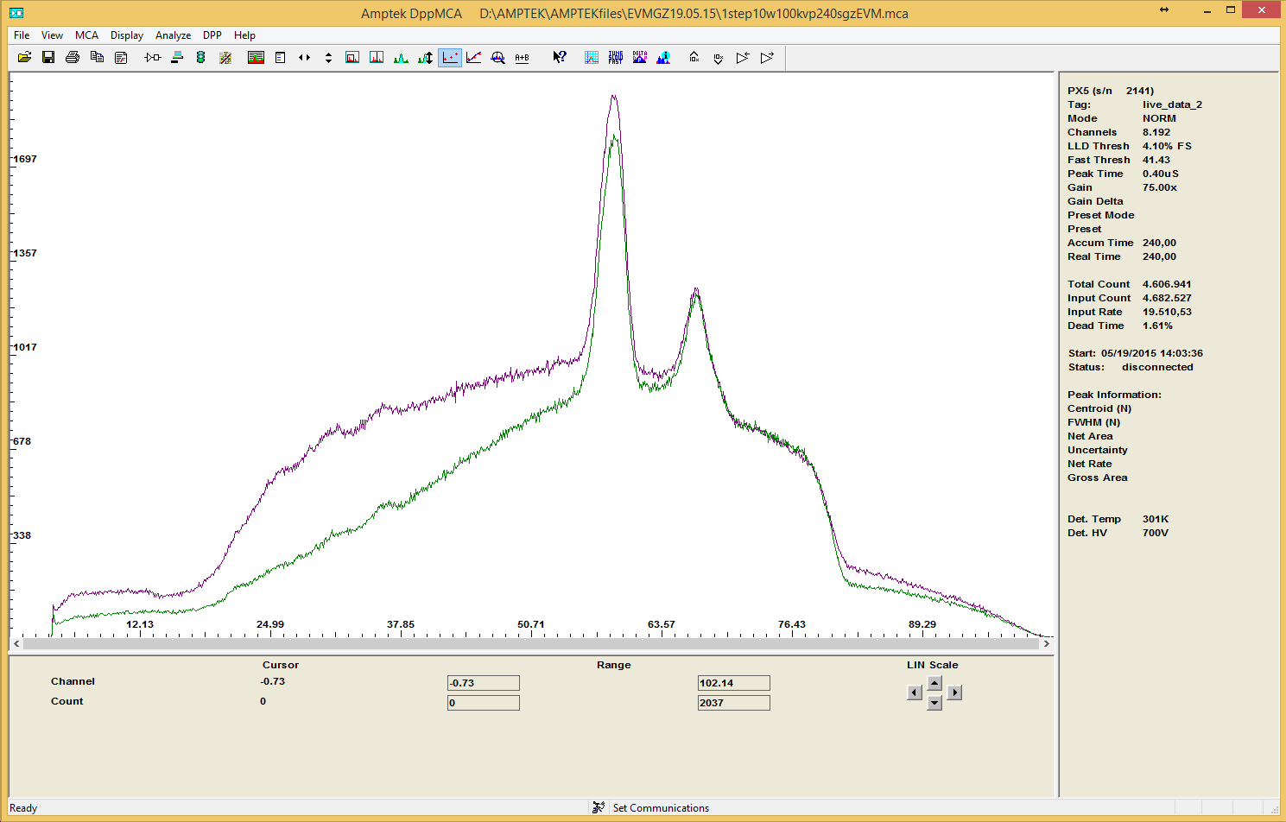
Spectra for the first stepp
The green spectrum is taken at the outer region, the purlpe one in the middle, of the gratings respectively.

